Slide 1

PROYEK SISTEM INFORMASI
Sistem Informasi Gereja HKI Parsoburan
SIGEPAR
SIGEPAR

Slide 2





PROJECT TEAM
12S19005
Amelia Jane Audri Lumbanraja
12S19025
Petrus Aquanur Sinaga
12S19030
Jaime Christ Bonar Sirait
12S19046
12S19052
12S19052
Sri Ningsih Ompusunggu
Mulyani G.S Simanjuntak
Mulyani G.S Simanjuntak
Amelia Jane Audri Lumbanraja

Slide 3

OVERVIEW
INTRODUCTION
Project description and background of project implementation
2. FUNCTIONAL & NON-FUNCTIONAL
List of functional and non-functional and which are implemented
3. DESIGN
Design Database & Design Mockup
4. TESTING
Software testing is a technique to ensure that the system has not any bug

Slide 4

INTRODUCTION
PROJECT DESCRIPTION AND BACKGROUND OF PROJECT IMPLEMENTATION

Slide 5
BACKGROUND
PURPOSE
Build a web-based system that is more efficient and effective to use
Build a web-based system that is more efficient and effective to use
More accurate data handling on HKI Parsoburan
Provide solutions related to current data handling problems
Easy of data management with a computerized system

Slide 6
2. FUNCTIONAL & NON-FUNCTIONAL
LIST OF FUNCTIONAL AND NON-FUNCTIONAL AND WHICH ARE IMPLEMENTED

Slide 7
Functional
Non-Functional
Login
Register
Announcement
Sacrament Registration
Statistical Report
Financial Report
Managing Church Data
Availability
Reliability
Ergonomic
Portability
Memory
Response Time
Safety

Slide 8
3. DESIGN
DESIGN DATABASE & MOCKUP

Slide 9
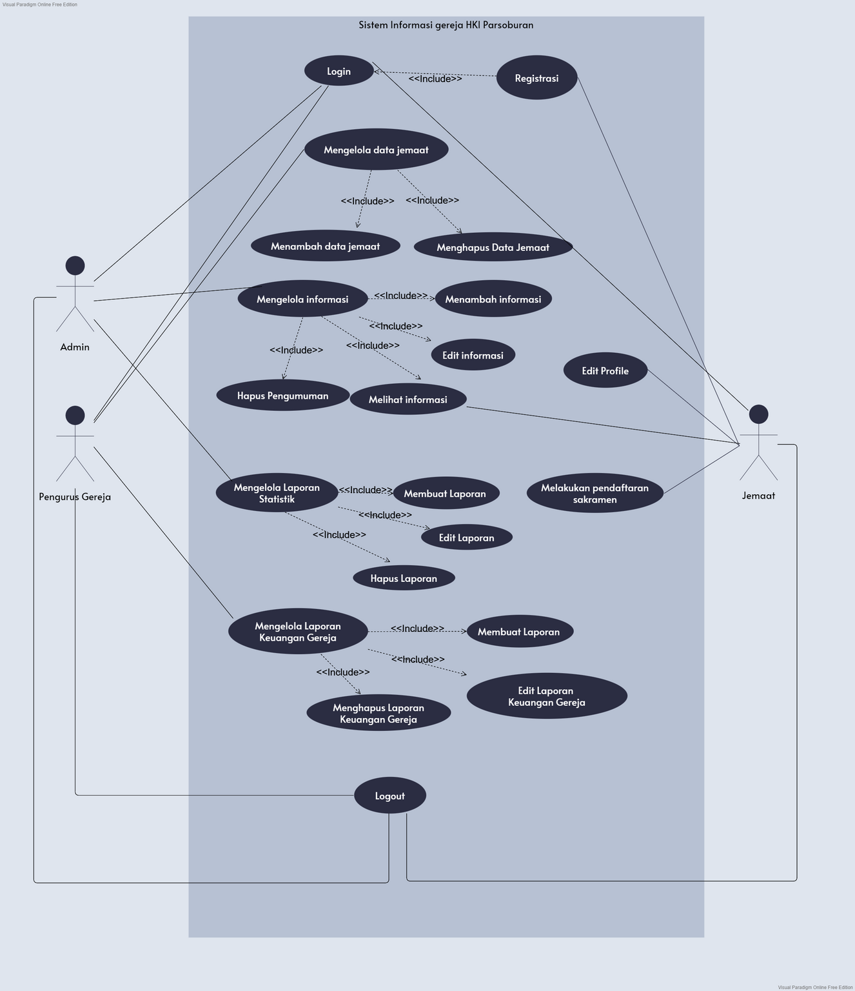
USE CASE DIAGRAM

Slide 10
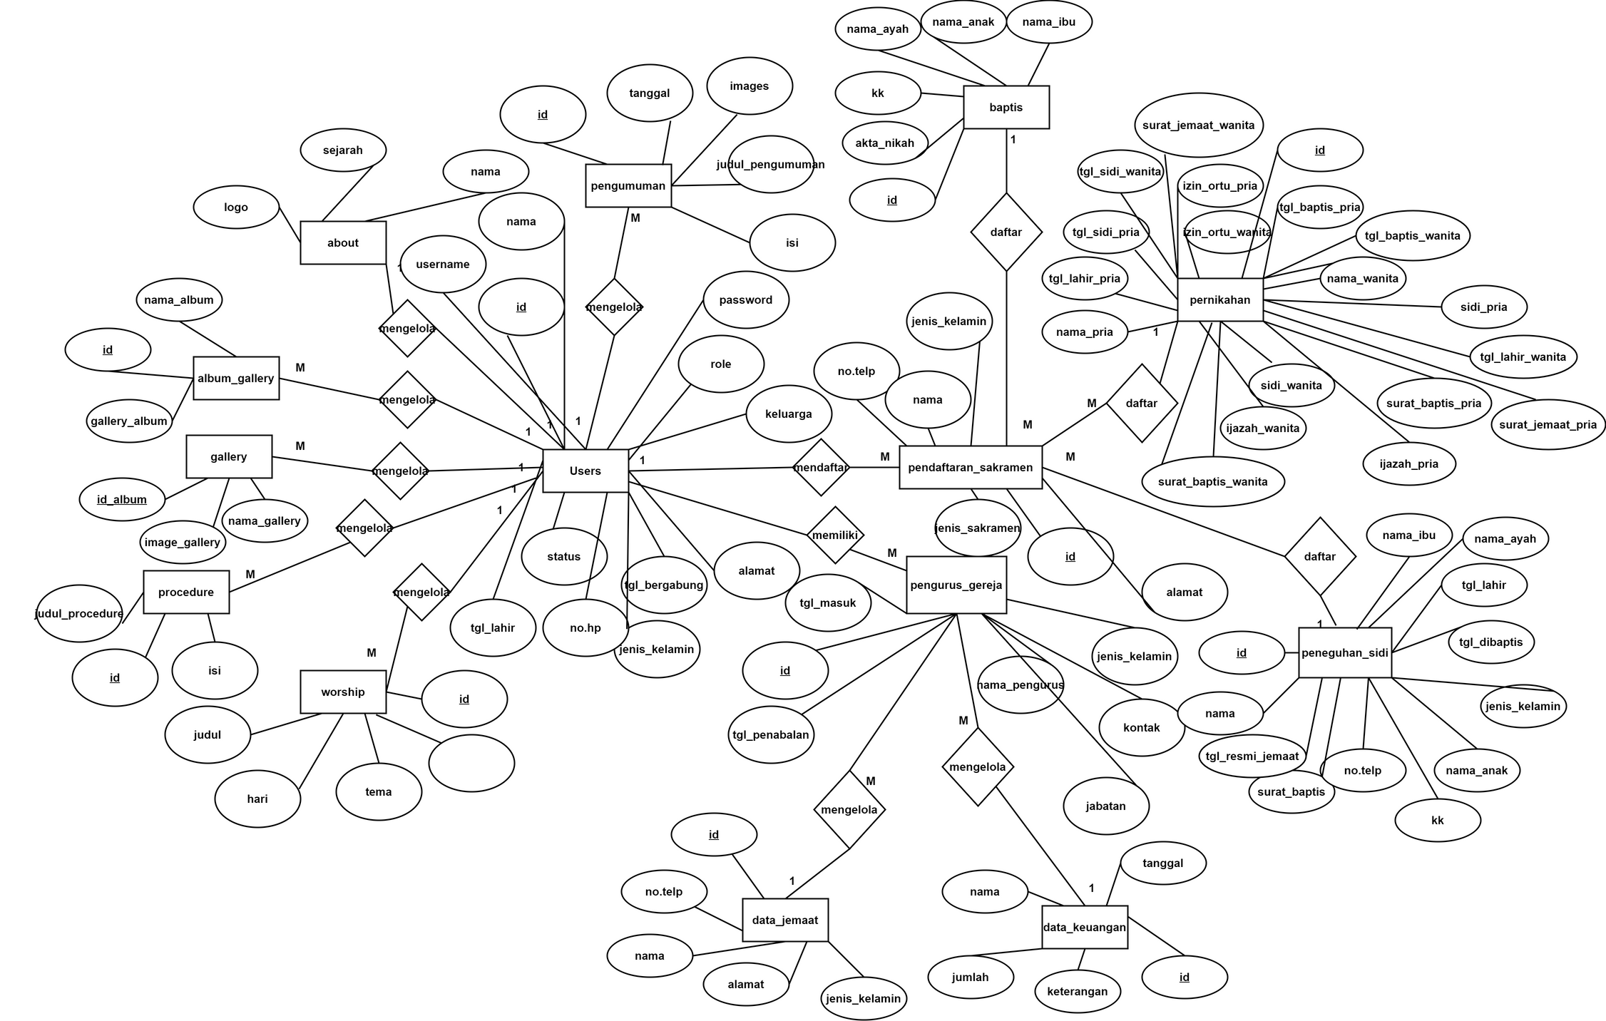
Entity Relationship Diagram

Slide 11
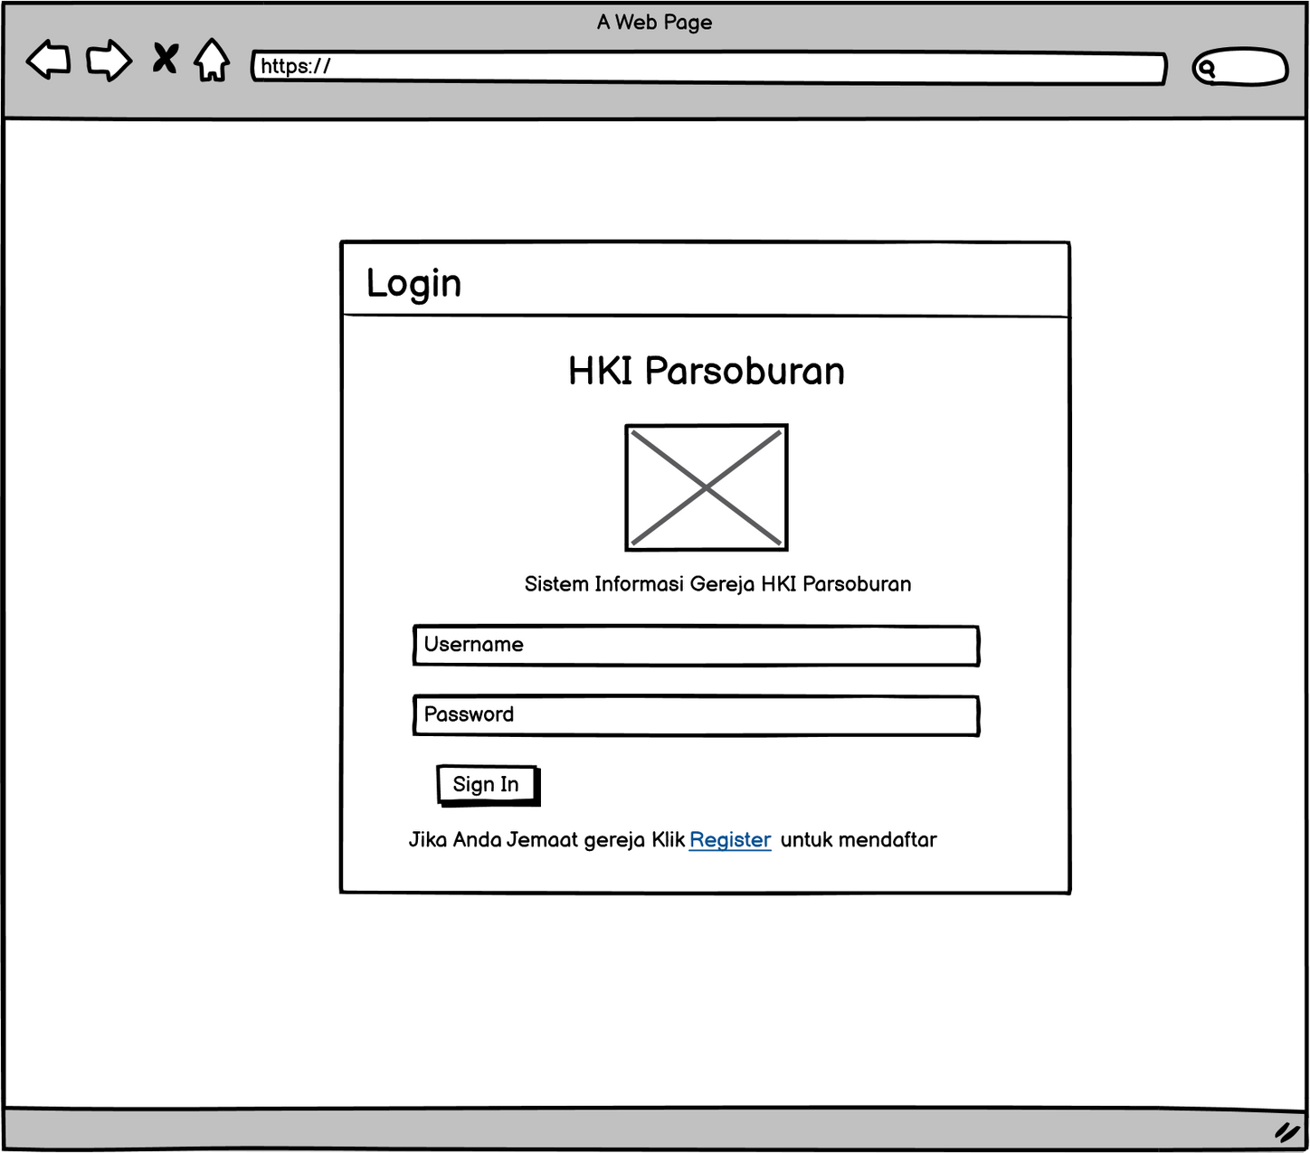
LOGIN

Slide 12
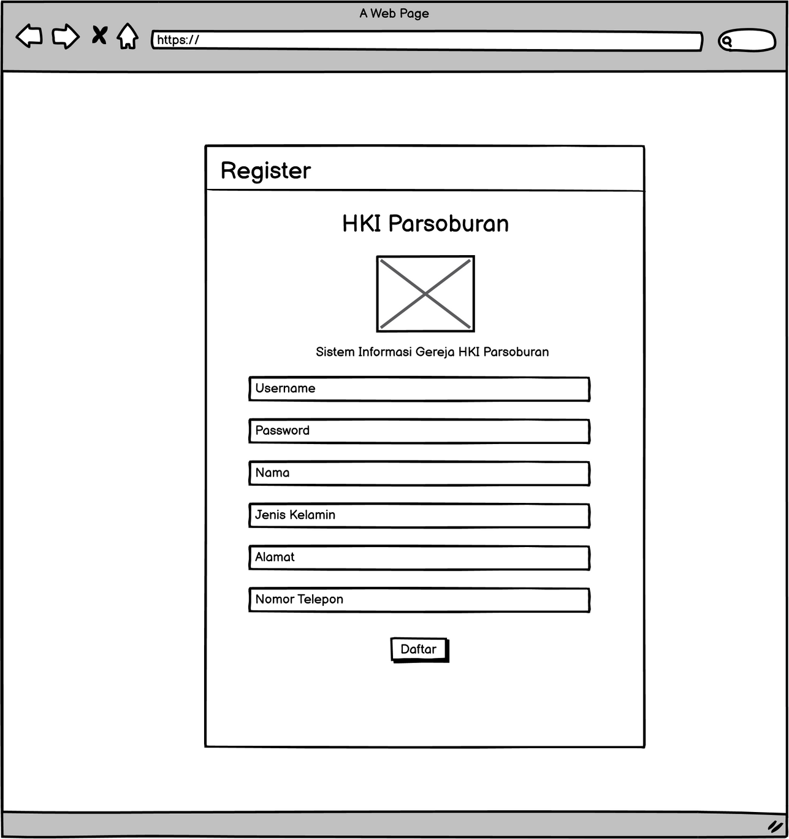
REGISTER

Slide 13
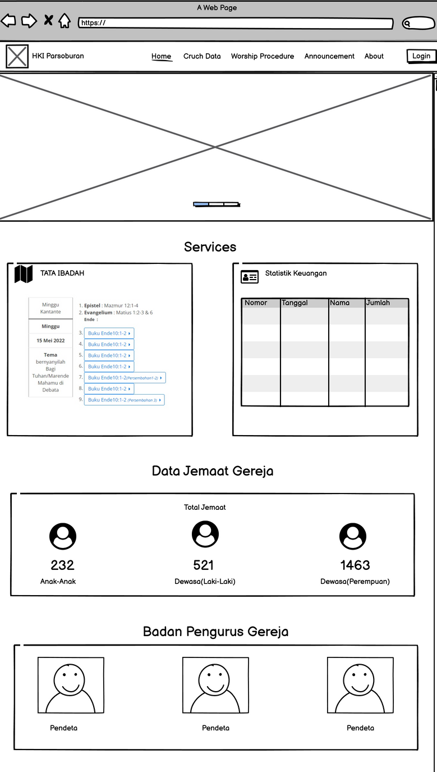
DASHBOARD

Slide 14
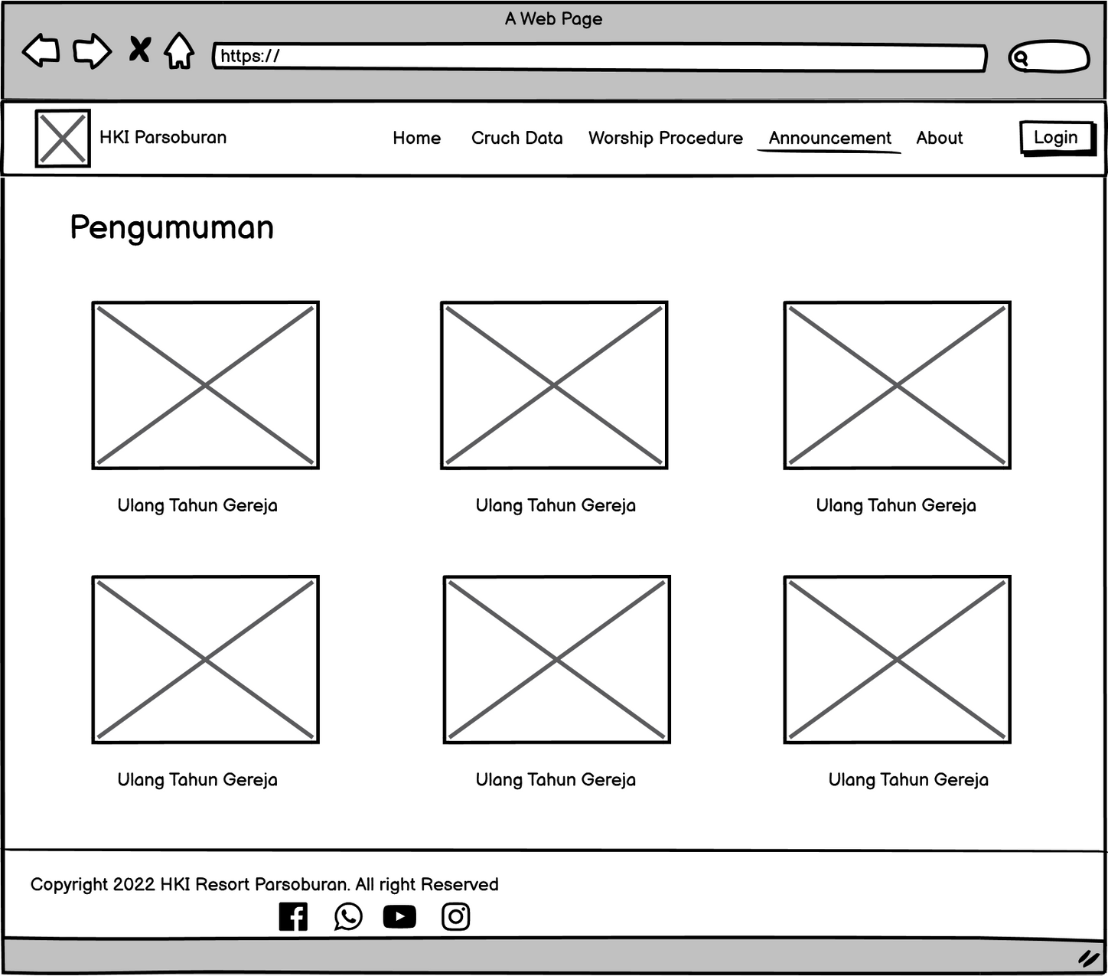
PENGUMUMAN

Slide 15
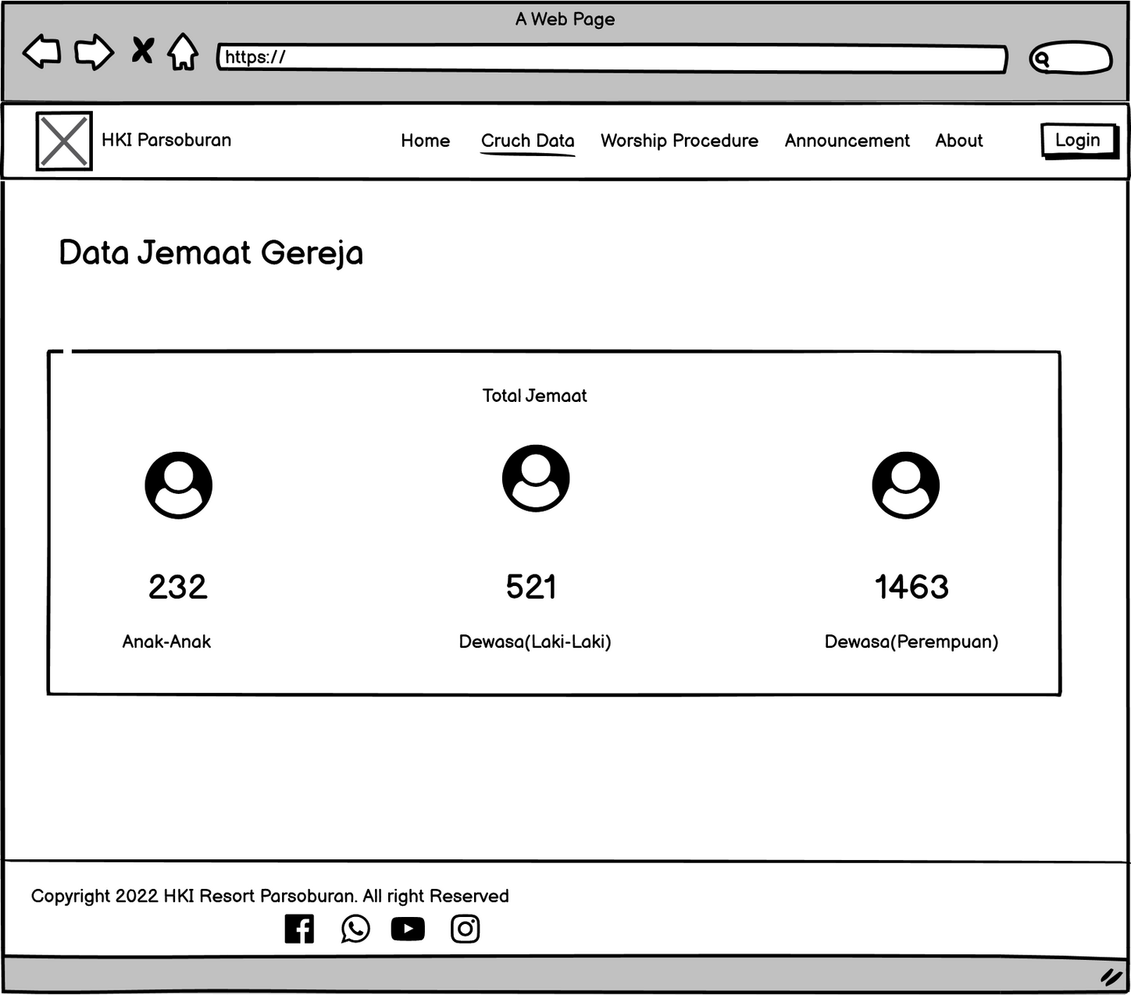
LAPORAN STATISTIK DATA JEMAAT

Slide 16
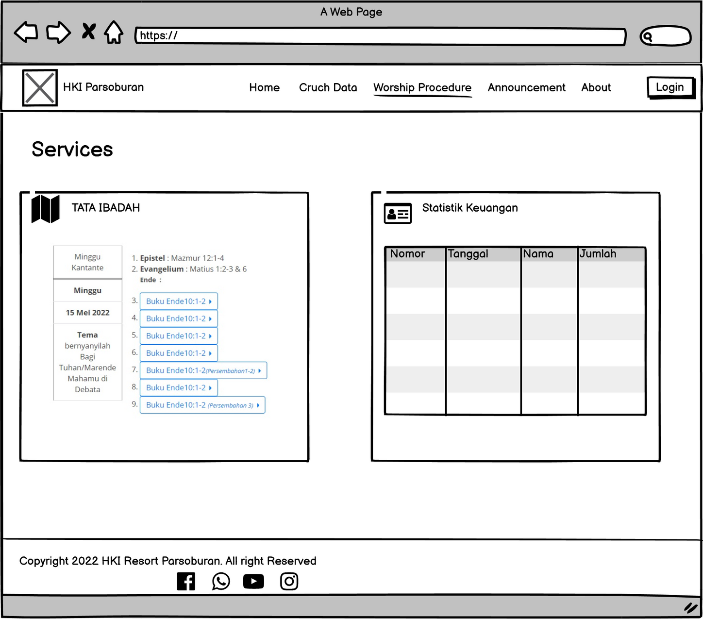
WORSHIP PROCEDURE

Slide 17
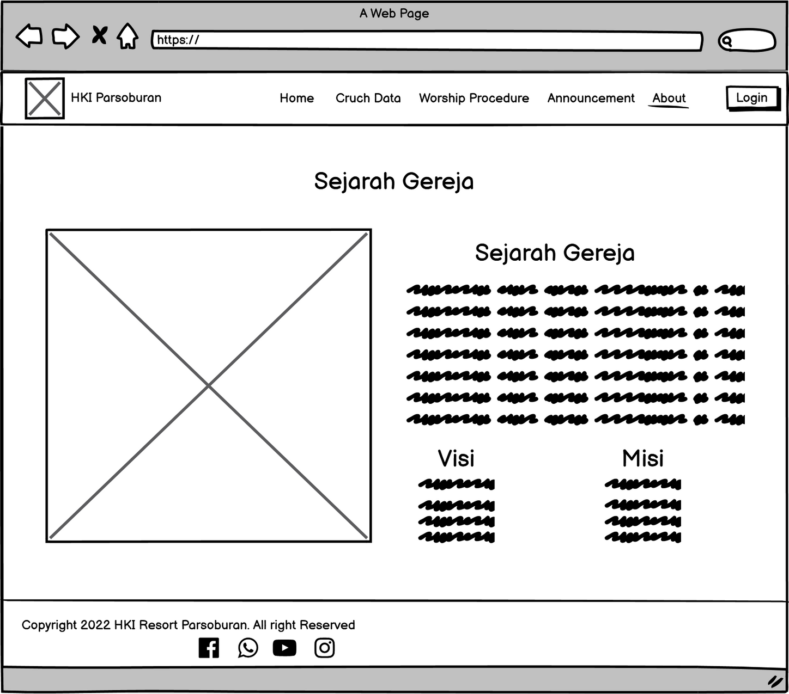
ABOUT

Slide 18
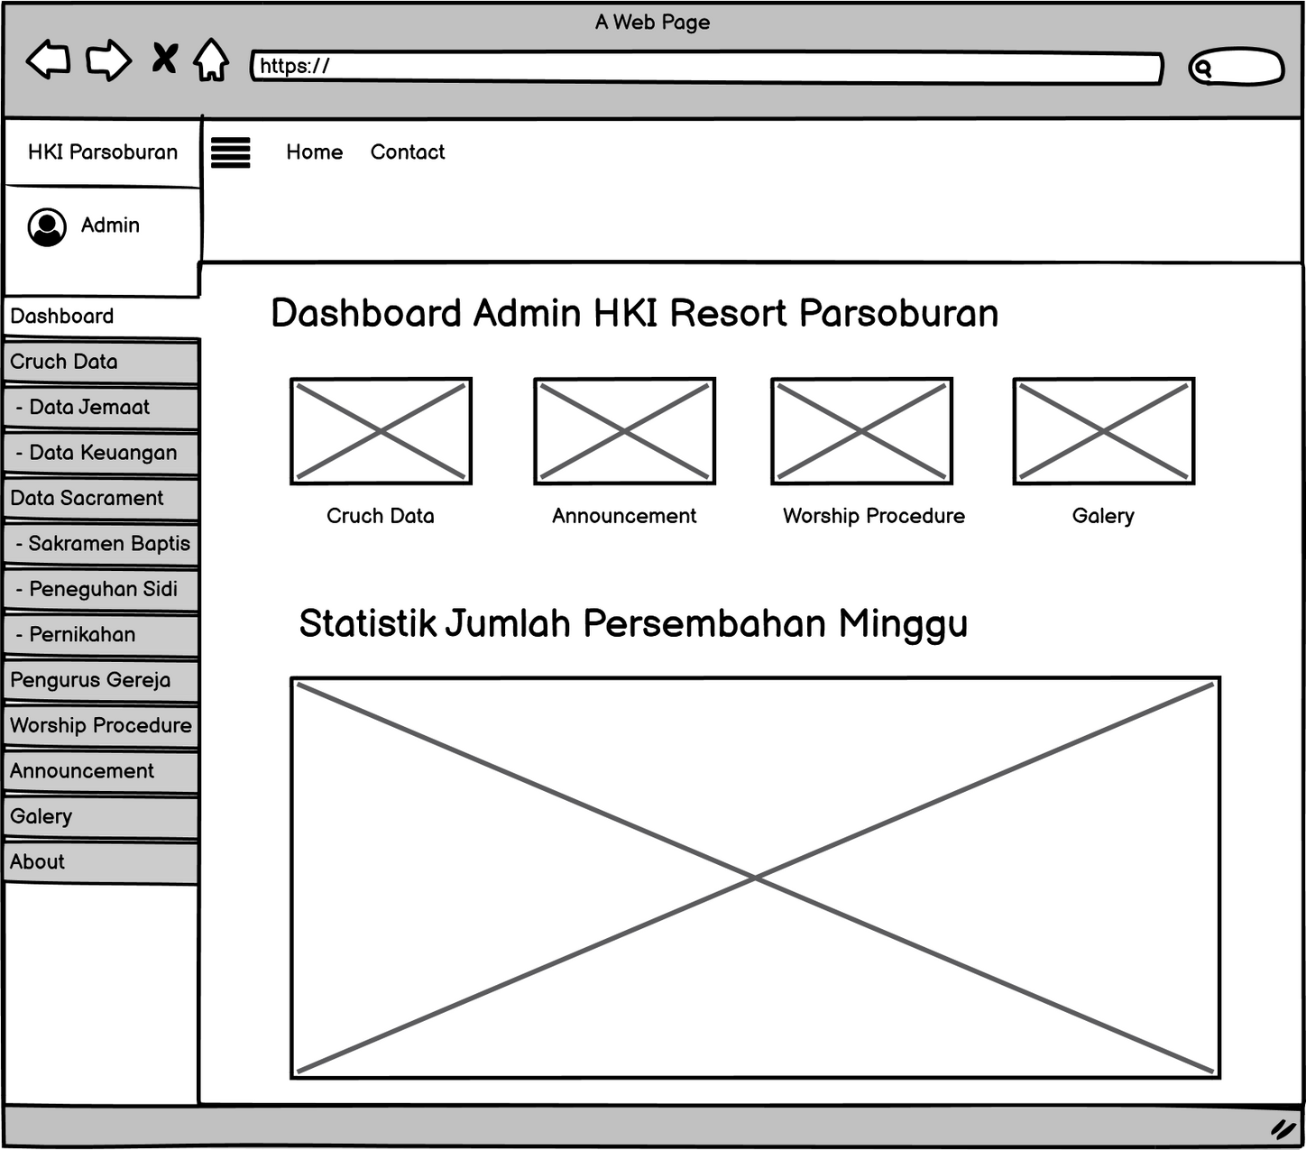
DASHBOARD ADMIN

Slide 19
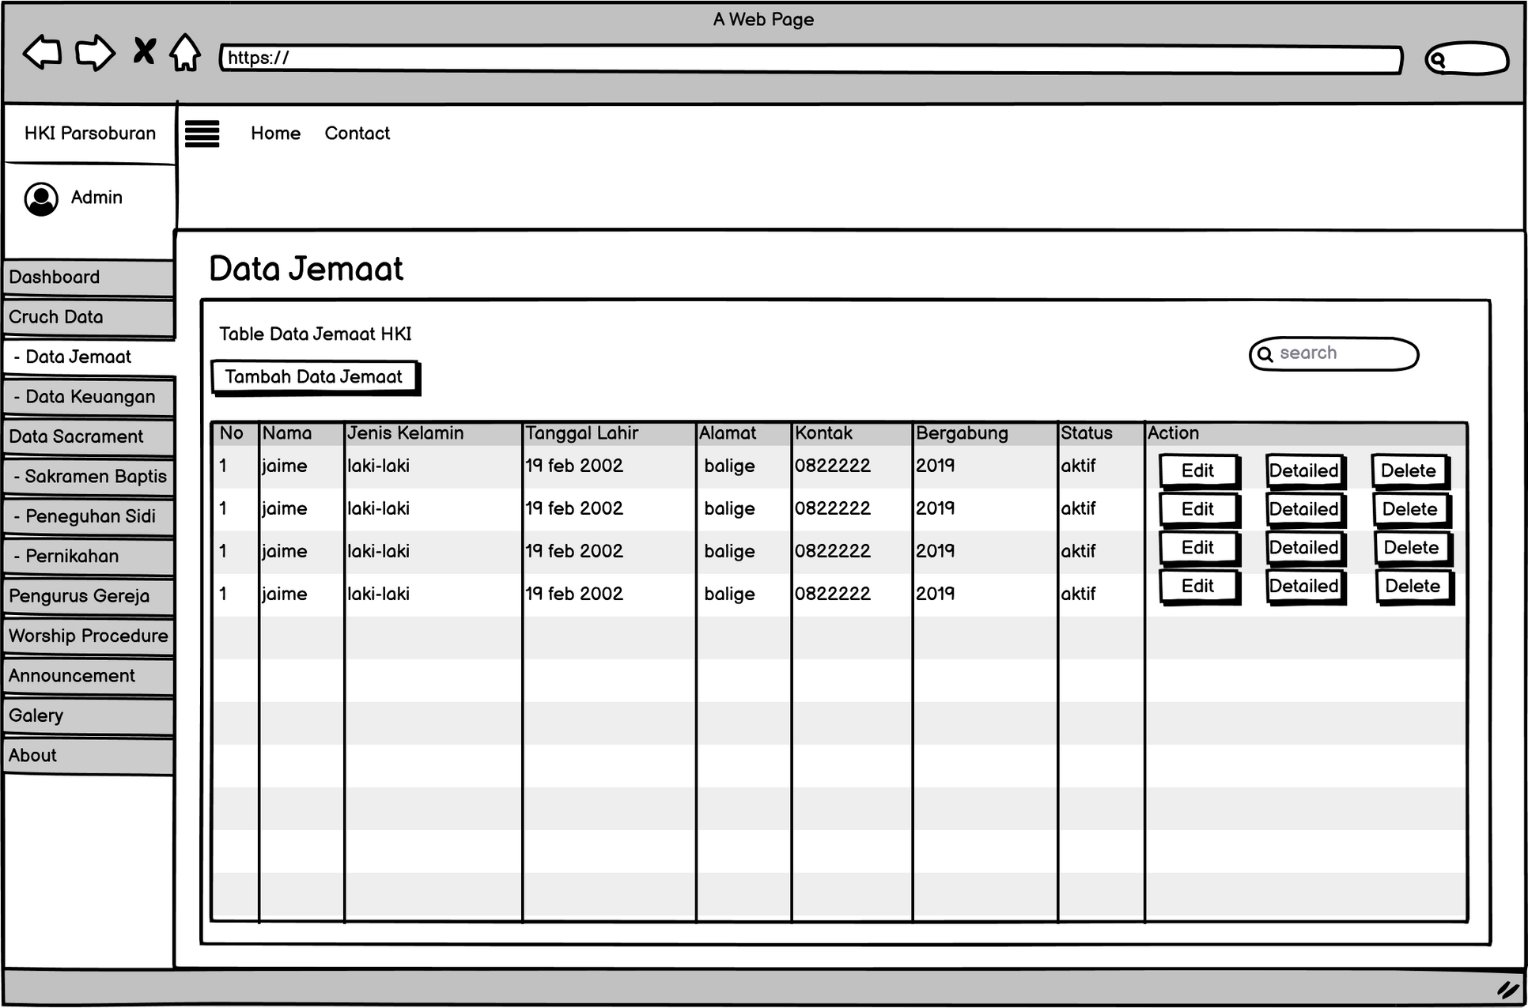
DATA JEMAAT

Slide 20
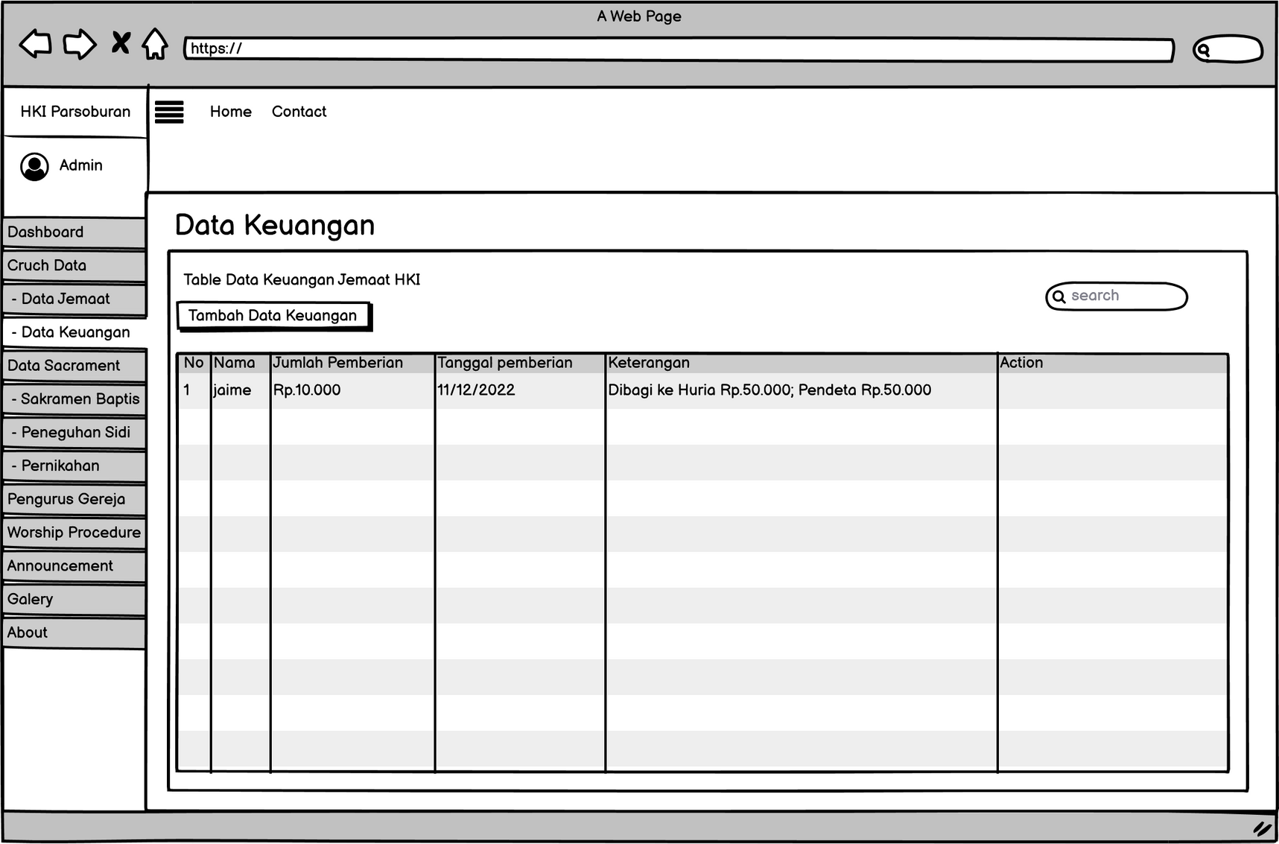
DATA
KEUANGAN

Slide 21
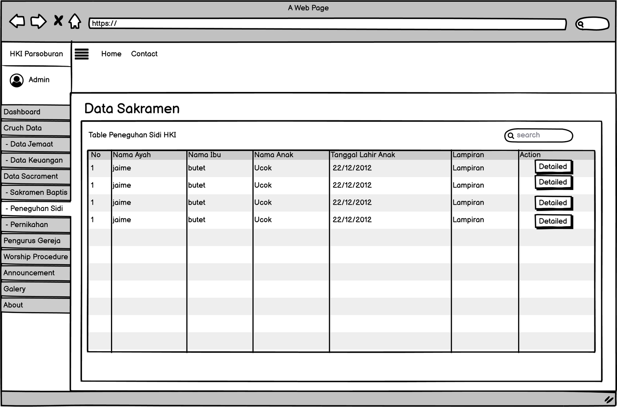
DATA SAKRAMEN

Slide 22
4. TESTING
SOFTWARE TESTING IS A TECHNIQUE TO ENSURE THAT THE SYSTEM HAS NOT ANY BUG

Slide 23
Testing is done using the black box method. Black box testing is a software testing method in which the functionality of a software application will be tested without having knowledge of the internal code structure, implementation details, and internal paths. Black box testing focuses on the input and output of software applications and is completely based on the requirements and specifications of the software.

Slide 24
Thank You

